Slide 1

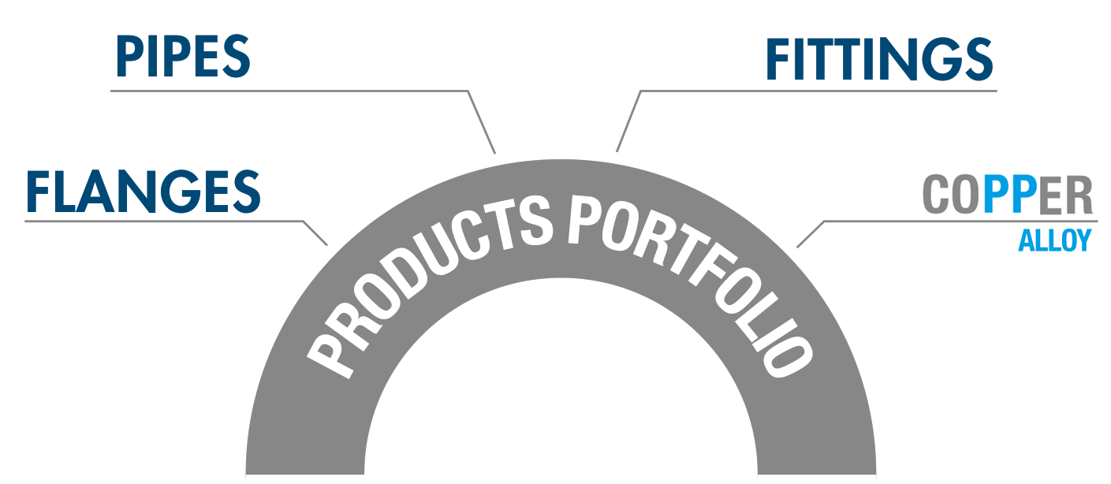
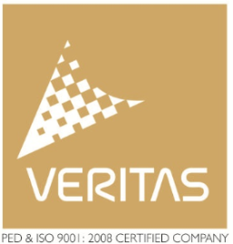
ADNOC approved supplier

Slide 2
ABOUT US
ROYAL VERITAS is the 100% owned subsidiary company office of the 3 Largest Steel Mills of India (Mehta Tube, Bhandari, Phoniex) We are producers of Industrial Piping materials. Our goal is to directly supply piping products and services to Energy, Chemical, Petrochemical, Shipbuilding and Mechanical industries globally
Our product portfolio consists of high quality industrial materials & products such as Steel Pipes, Pipe Fittings, Flanges, Plates. Materials of Construction of the products range from Stainless Steels, Nickel Alloys, Copper & Brass Alloys, Carbon Steels and low temperature grades to high yield grades, low and high Alloys, other, Chrome Moly.
We are constantly expanding our product range to maintain the standards of global Piping Industry. All materials/products confirms to international standards such as API, ASTM, ASME, ISO, DIN & EN.

Slide 3
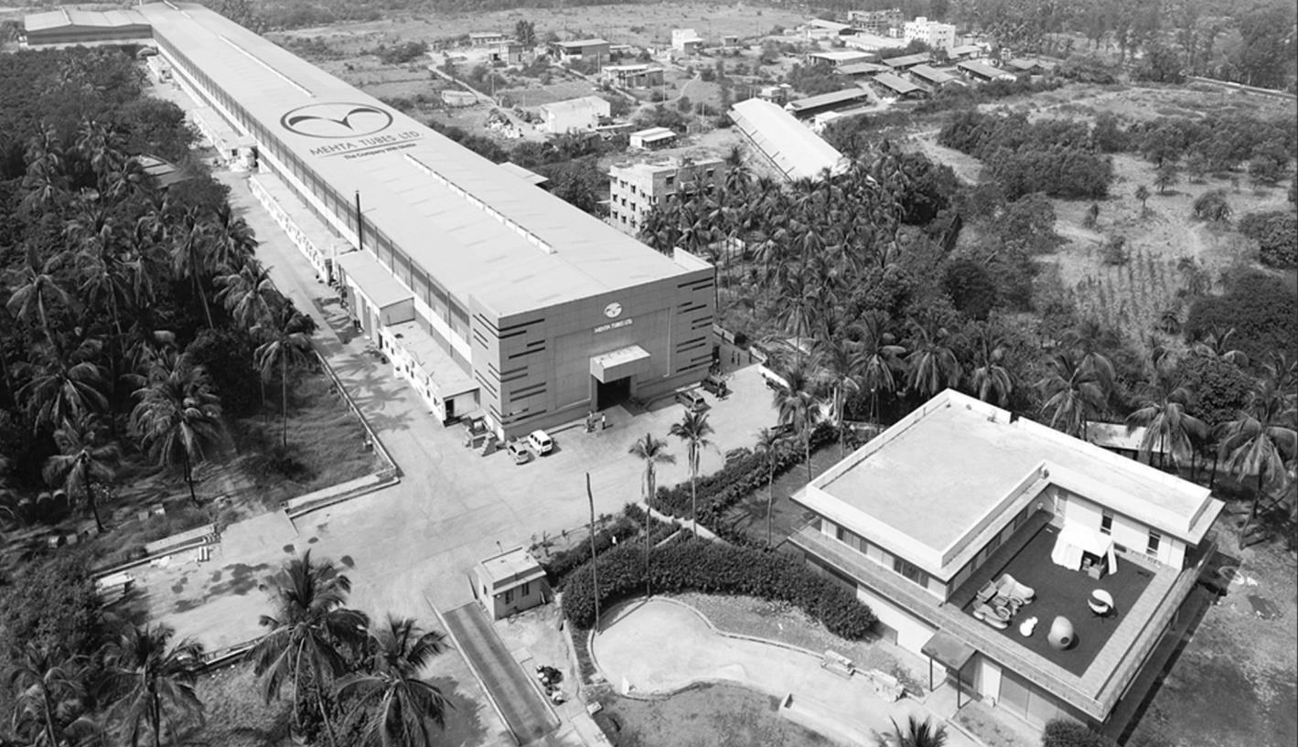

COPPER ALLOYS PRODUCTION
Mehta Tubes is a ADNOC approved and India’s largest manufacturer & exporter of copper and copper alloy tubes, bus bars, strips, rods, profiles, sections etc. We are also the largest exporter of copper tubes for HVACs, Gas and Medical applications, copper nickel tubes for marine, condenser & heat exchanger applications
Copper Tubes & Brass Tubes
Heat Exchanger & Condenser Tubes
Admiralty Brass Tubes C443
Aluminium Brass Tubes C687
Aluminum Bronze
shaju@mehta-group.com

Slide 4
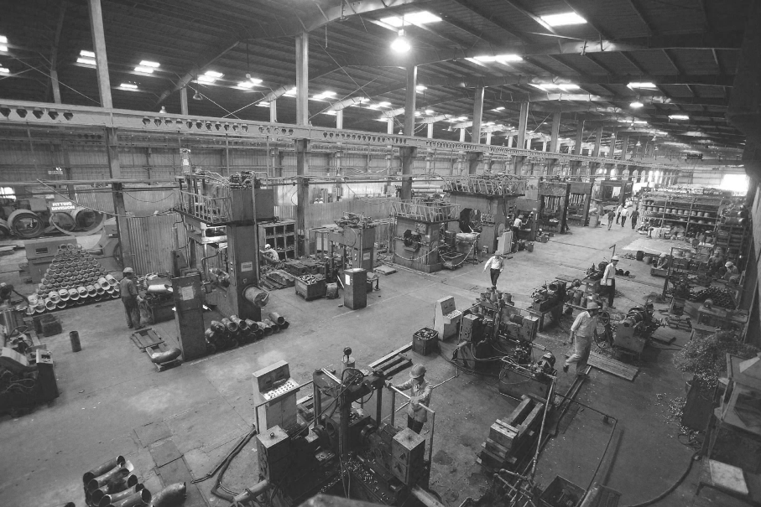
PIPE & FITTING PRODUCTION
Bhandari is the largest Stainless Steel / Super Duplex Pipes & Fittings & Fabrication manufacturing company in India. BFTL is just not only manufacturing products but also delighting customers through its unmatched quality.
middleeast@bhandarigroup.in
Pipe & Tube (Seamless 1/2” - 10” & Welded 1/2” to 60”)
Butt-weld Fittings (Size 1/2” to 24”)
FABRICATION – We are the only Indian company having accreditation of 10 CFR 50 APPENDIX-B, PART 21 to manufacture components and piping for Nuclear Industry.
FABRICATED CUSTOMISED ENGINEERS PRODUCT

Slide 5
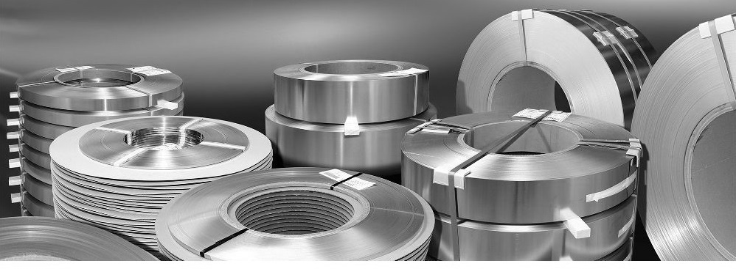
FOILS PRODUCTION
Phoenix Foils is India’s largest producers of stainless steel cold rolled coils, foils & press components, is strategically located in India.
Our state-of–art rolling facility is setup over an expanse of 5 acres (210000 Sq.Ft.) with an annual capacity of producing 5000 MT of high quality Stainless Steel cold rolled Coils & Foils.
THICKNESS : 0.05 to 3.00mm up to a maximum width of 350 mm (15”)
GRADE : 304, 304L, 316, 316L, 316L High Moly, 317L, 321, 347, 409L, 410S, 430, 904L, Duplex 2205 & other grade as per client requirement
SURFACE FINISH 2B (Skin Passed), BA (Bright Annealed), CR (As Rolled)
EDGES Slit, Round, De-burred (details on request)
shaju@phoenixfoils.com

Slide 6
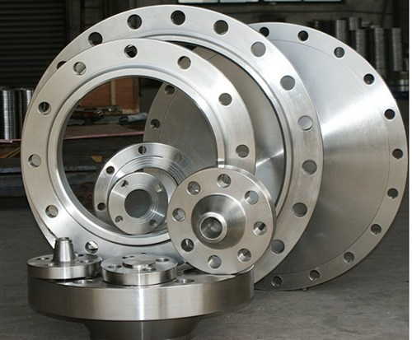


EXCLUSIVE AGENTS - KUNJ FORGING INDIA
Kunj Forgings, India is a approved manufacturer providing the highest quality of products and services and being a one stop solution to cater to all your forging needs
shaju@kunjforge.in
PRODUCT : FORGE FLANGES

Slide 7
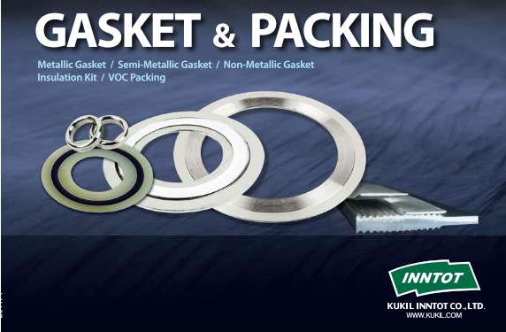


EXCLUSIVE AGENTS – SEALING PRODUCTS
Kukil Inntot Co., Korea. was founded in 1982. The company's line of business includes the manufacturing of gaskets, packing, and sealing devices
PRODUCT : GASKET & INSULATION KIT
MAKING THE WORLD SAFER & CLEANER THROUGH ENGINEERED SEALING SOLUTIONS

Slide 8
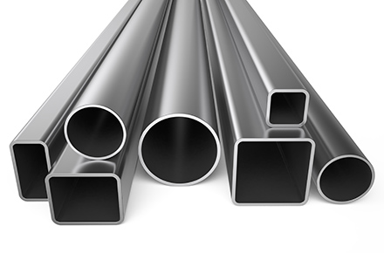
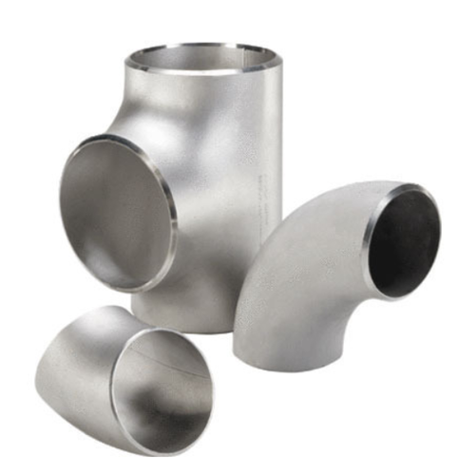
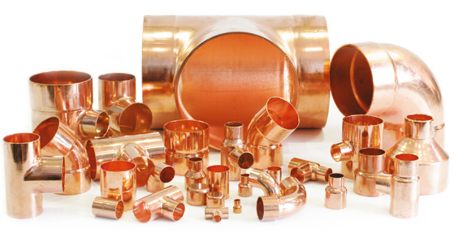
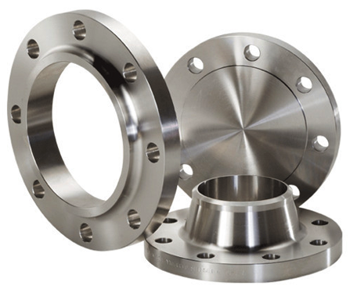
OUR PRODUCT SPECIALITY

Slide 9






OUR CLINET

Slide 10


Office : PO Box 94449, 1st Floor, Remah Towers, Khalidiya, Abu Dhabi.
Stockyard : Jebel Ali Free Zone – South, Jebel Ali, Dubai
Tel No. : +971 - 2446 7211
Email : info@royalveritas.ae

